Slide 1
False Position Method (Regula Falsi)
Numerical Methods - Root Finding Technique

Slide 2
Concept of False Position Method
• Bracketing method for root finding.
• Uses linear interpolation between two points.
• Requires function to be continuous in [a, b] and f(a)·f(b) < 0.
• More efficient than Bisection in some cases.

Slide 3
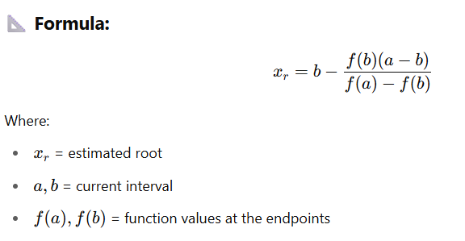
Formula and Steps

Slide 4
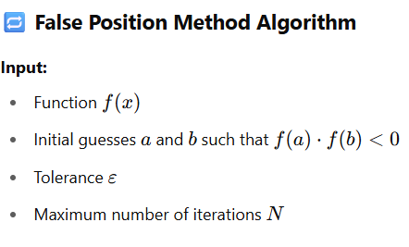
False Position Method Algorithm

Slide 5
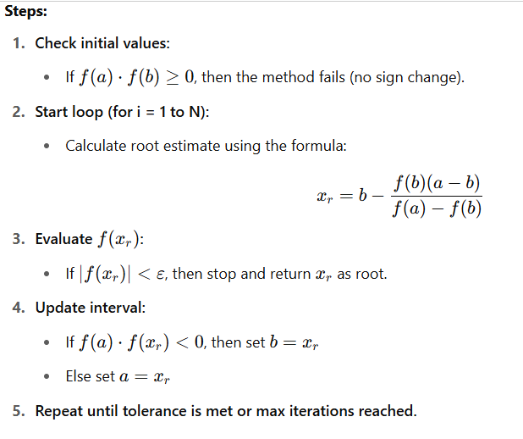
False Position Method Algorithm

Slide 6
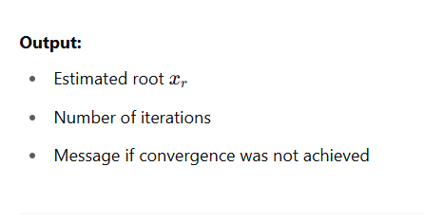
False Position Method Algorithm

Slide 7
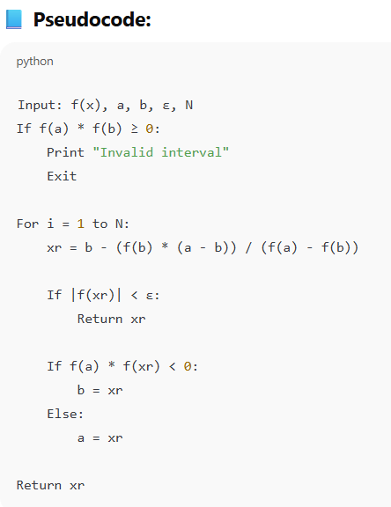
False Position Method Algorithm

Slide 8
Real Example: f(x) = x³ - 4x + 1
Initial Interval: [0, 1]
f(0) = 1, f(1) = -2 → Sign change exists
Step 1:
xr = 1 - [-2*(0-1)] / [1 - (-2)] = 0.3333
f(0.3333) ≈ -0.7037
Step 2:
New interval: [0, 0.3333] → Repeat steps

Slide 9
Advantages and Disadvantages
Advantages:
• Faster than bisection in many cases
• Bracketed method ensures root lies in interval
Disadvantages:
• May converge slowly if one function value is small
• Not always faster than bisection

Slide 10
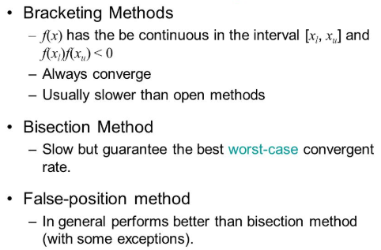

Slide 11
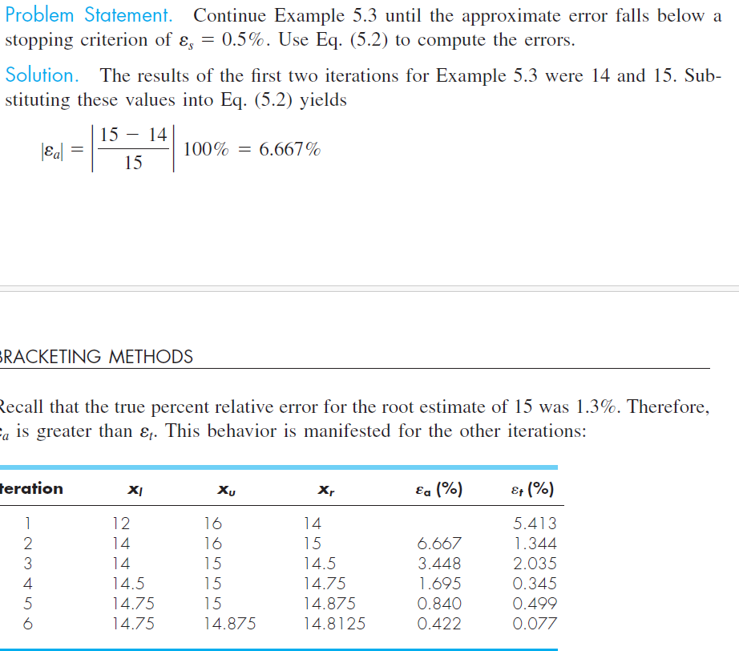
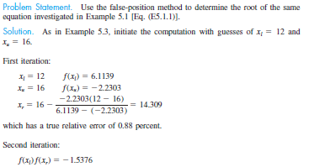
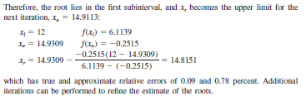
False Position vs Bisection (regular case)

Slide 12
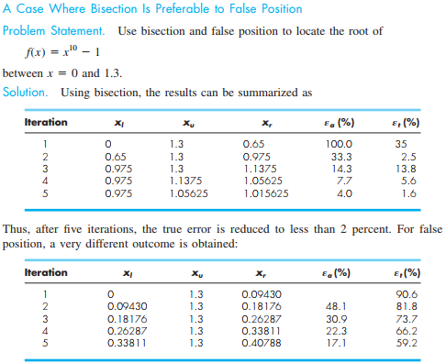

Slide 13
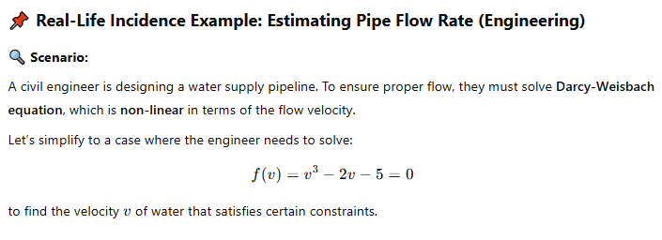

Slide 14
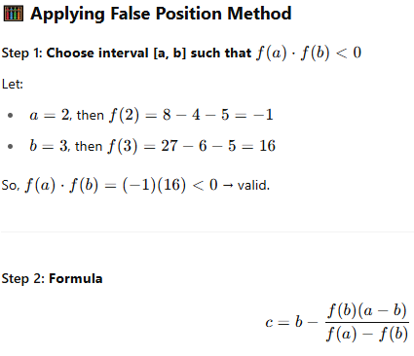

Slide 15
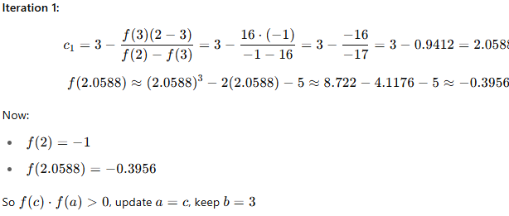

Slide 16
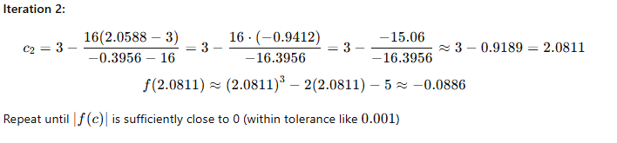

Slide 17
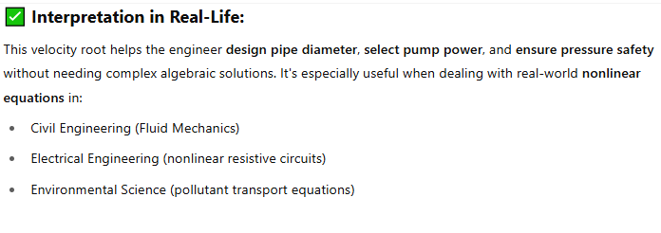

Slide 18
